Slide 1
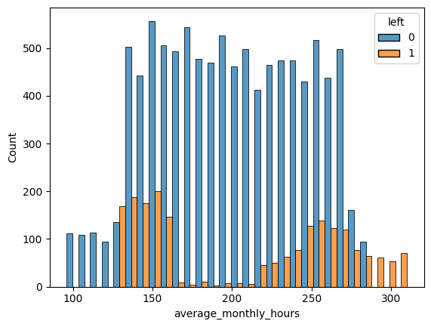
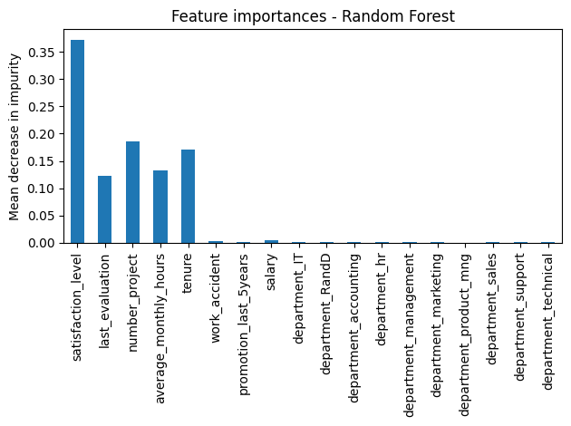
Salifort Motors
Employee Retention
The HR department at Salifort Motors wants to take some initiatives to improve employee satisfaction levels at the company.
Analyze the data collected by the HR department and to build a model that predicts whether or not an employee will leave the company.
Average monthly hours over 278 are a clue to retention.
If we can predict employees likely to quit, it might be possible to identify factors that contribute to their leaving. Because it is time-consuming and expensive to find, interview, and hire new employees, increasing employee retention will be beneficial to the company.
Employee satisfaction, evaluation, number of projects, and tenure affect retention
Key areas that affect employee retention are satisfaction level, last evaluation rating, number of worked projects, and tenure.
Employees who work a monthly average over 287 hours per month tend to leave the company.
Employees working on 7 projects will leave the company.
If an employee report a satisfaction level of zero, they will most likely leave the company.
The key take-aways are if an employee feels like they are being overworked, they will leave.
Offer incentive programs for hard workers or create a policy limiting monthly hours.

